Slide 1
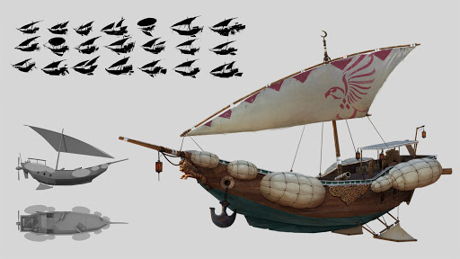
Workshop 1 CHALLENGE

Slide 2
Bonus Task
Gather different reference images on boats
Choose one of the boats from your reference images
Model the boat as best as you can

Slide 3
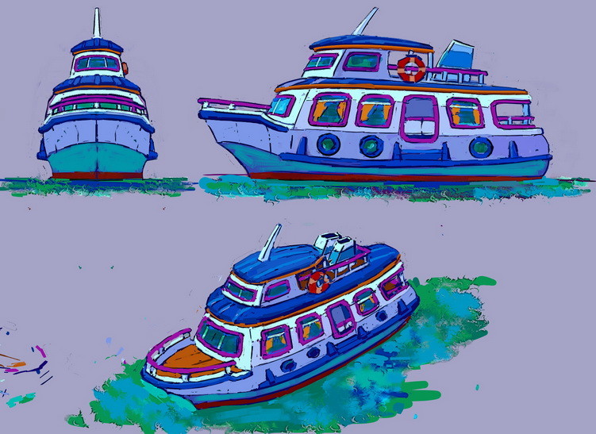
Reference Images
Search the internet for multiple different types of boats. They can be modern, fantasy, sci-fi – its up to you.
If you’re finding it hard to find good reference images, try searching Art Station https://www.artstation.com

Slide 4
Reference Images
Add your reference images here:

Slide 5
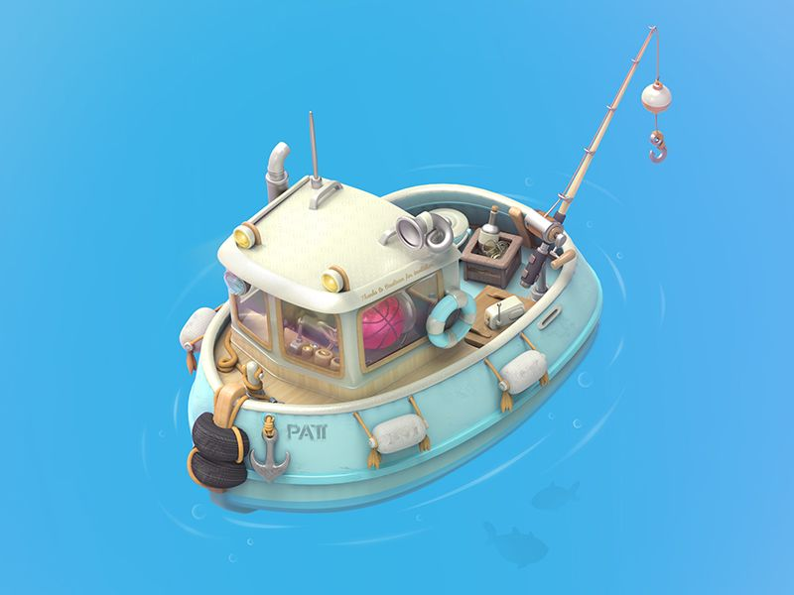
Modelling
Once you’ve chosen a boat to model, start to model it inside of Blender. Remember to paste a screenshot of the boat on the next slide of the powerpoint.
You can print your screen or use Windows Snipping Tool.
Remember to SAVE your work. We’ll be using the boat more later.

Slide 6
Final
Paste a screenshot of your boat here

